Slide 1
Data Leakage Prevention System
Git Hub Link: https://github.com/lpatil22/PISP-Data-Leakage-Prevention-System
Presented By : Lavannya Patil

Slide 2
Introduction
Data leaks can happen accidentally or maliciously.
Sensitive information includes: Emails, Passwords, Credit Card numbers, SSNs.
Enterprises must prevent leaks to avoid financial and legal risks.

Slide 3
Objectives
Detect and block sensitive data patterns (e.g., emails, passwords, credit cards).
Log all potential data leaks with timestamps.
Mask sensitive information before displaying or storing it.
Provide a simple and interactive way to test the system using POST requests.

Slide 4

Key Features
Dynamic rule-based detection
Supports multiple sensitive data types
Real-time alerts and logging

Slide 5
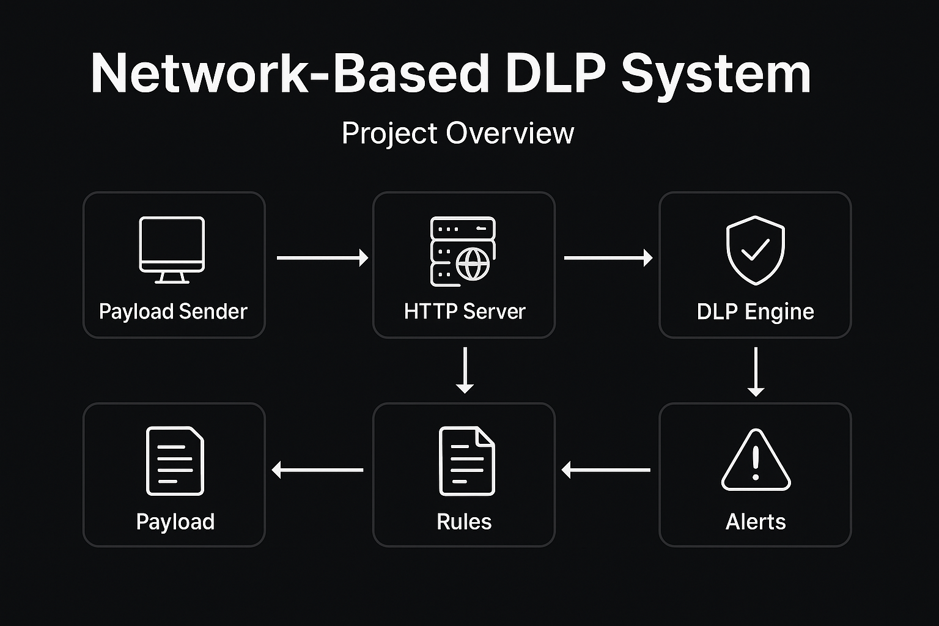
Project Architecture

Slide 6
Core Components
Component | Usage
post_server.py | Runs HTTP server and checks incoming POST data for sensitive content.
network_dlp.py | Core analyzer that scans payloads, matches regex patterns, and logs alerts.
rules.json | Stores regex rules for detecting sensitive data like emails, cards, and SSNs.
utils.py | Provides helper functions for masking and data validation.
send_payload_http.py | Client script to send test data to the server.
alerts.log | Stores logs of detected sensitive data with timestamps.

Slide 7
File 1: network_dlp.py
Purpose:
Performs analysis on incoming payloads and identifies sensitive patterns.
Key Functions:
load_rules() → Loads regex rules.
analyze_payload() → Scans payload using regex.
log_alert() → Records timestamped alerts.

Slide 8
File 2: post_server.py
Purpose:
Acts as a local HTTP POST server that filters incoming data.
Key Actions:
Receives POST request from client.
Runs DLP analysis.
Prints “BLOCKED” or “ALLOWED”.

Slide 9
File 3: rules.json
Purpose:
Stores detection rules in JSON format.
Examples of Patterns:
Sensitive Data Type | Example Regex
Email Address | [A-Za-z0-9._%+-]+@[A-Za-z0-9.-]+\.[A-Za-z]{2,}
Credit Card Number | (?:\d[ -]*?){13,16}
SSN | \d{3}-\d{2}-\d{4}
Password Field | `(password
High Entropy String | (?=.*[A-Z])(?=.*[a-z])(?=.*\d)...

Slide 10
File 4: utils.py
Purpose:
Provides helper functions for masking and validation.
Functions:
luhn_checksum_is_valid() → Validates credit card numbers.
partial_mask(data) → Masks all but last 4 characters.
mask_sensitive_data(text) → Fully masks sensitive text

Slide 11
File 5: send_payload_http.py
Purpose:
Acts as the test client to simulate user data being sent to the server.

Slide 12
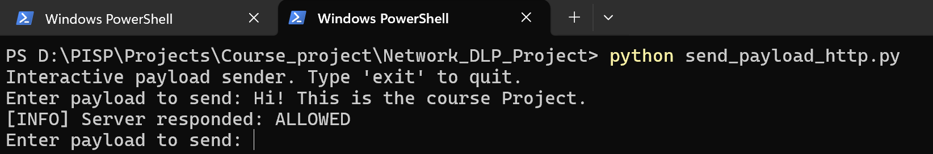
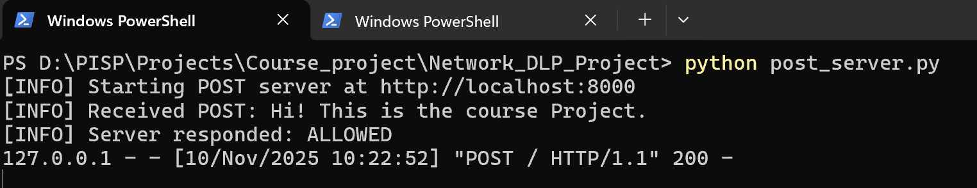
Sample Output
Case 1:Non-Sensitive Data

Slide 13
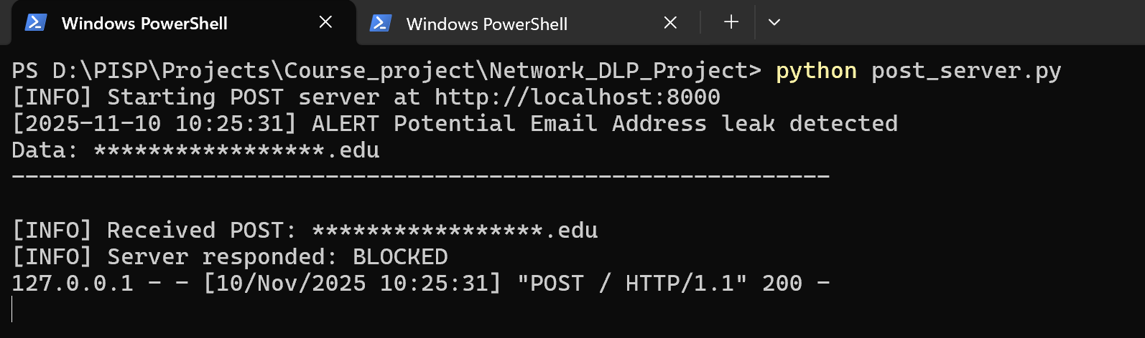
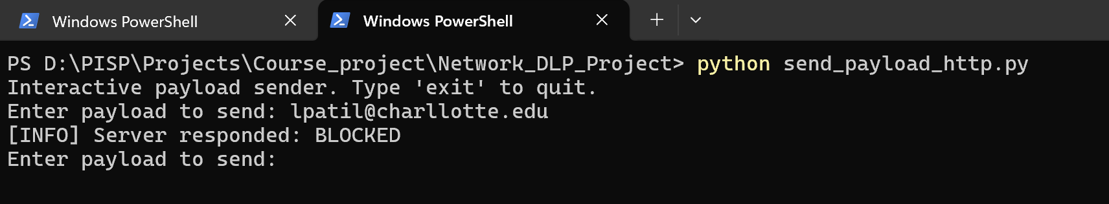
Case 2: Sensitive Data

Slide 14
Features and Advantages
Real-time data scanning and blocking.
Supports multiple sensitive data types.
Modular and easily extensible with new rules.
Logs all alerts for audit and compliance.
Lightweight — no external frameworks needed.

Slide 15
Limitations
Limitation | Description
Regex-based detection | Can only detect predefined patterns — may miss new or complex data types.
No encryption analysis | Encrypted or encoded data cannot be inspected.
Local scope | Works only on local server (not yet integrated with real network traffic).
No user authentication | Anyone can send POST requests; no access control.
Static rules | Rules must be manually updated in rules.json.
Limited scalability | Designed for small-scale demo, not enterprise-level performance.

Slide 16
Future Enhancements
Add
machine learning for anomaly detection.
Integrate
with database for alert storage and reporting.
Build
a web dashboard for visualization.
Expand
to file and email DLP (not just network).

Slide 17

Thank You!!

